Slide 1
What Aviation Means to Our Economy
Here is your customizable template.
Make sure you look in the Note field below for a suggested script!
Delete yellow sticky notes from slides after you read the directions.
YOUR AIRPORT LOGO
[Your Name]
[Your Airport’s Name]
[Date of Presentation]
Notes:
We appreciate the support this community gives to the airport.

Slide 2
Agenda
Welcome
North Carolina: The State of Aviation 2025
Economic Impacts of [Add Your Airport’s Name]
Q&A
Notes:
Today, I’d like to share information about the North Carolina’s airports on our community and state, as well as what’s going on at [INSERT YOUR AIRPORT NAME]

Slide 3
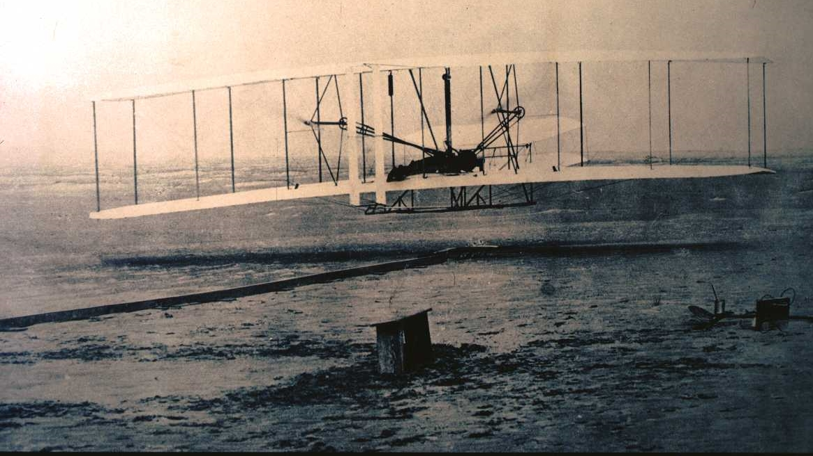
North Carolina:
First in Flight
Notes:
As you know, North Carolina has been at the forefront of aviation since the Wright Brothers’ first flight at Kitty Hawk in 1903.
Today, the state’s network of 72 publicly owned airports, and the aviation and aerospace assets that rely on them, help move our economy forward by:
Creating jobs
Supporting business growth and
Connecting people and companies to markets around the globe.

Slide 4
N.C. Airports Annual Economic Impacts
Based on 2023 airport data
Notes:
A new report published in January (2025) by the N.C. Department of Transportation’s Division of Aviation quantifies the impact of our airports on the state’s economy.
The report revealed the results of an economic impact study showing that North Carolina’s public airports – of which [ADD YOUR AIRPORT NAME] is one – each year contribute more than:
$XX billion in economic output
XXX jobs
$XX billion in personal income for those workers
$XX billion in state and local tax revenues.
That $XXX billion represents a significant return on state and local investment in our state’s airports.
NCDOT creates the report every two years to help guide future investment in aviation infrastructure and provide a tool for recruiting aviation and aerospace industry companies and investment.

Slide 5
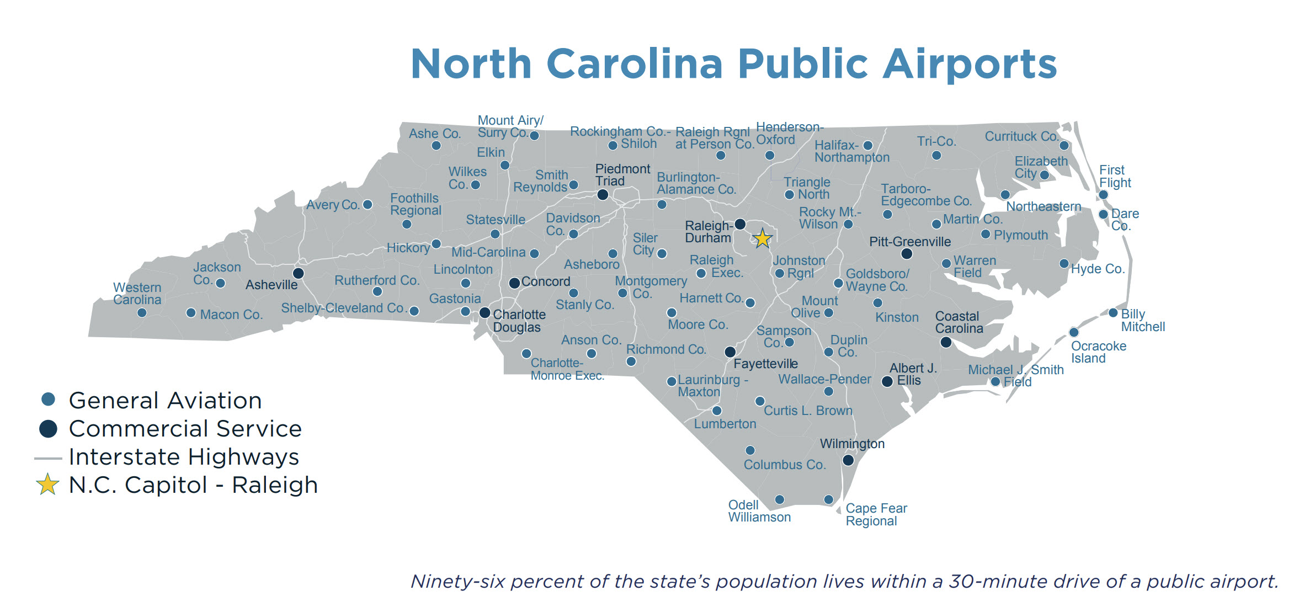
North Carolina’s Public Airports
72 Airports | 10 Commercial Service | 62 General Aviation
96% of N.C.’s population lives within a 30-minute drive of a public airport
Notes:
North Carolina’s public airport system comprises 72 airports:
10 are classified as commercial service, meaning they offer regularly scheduled passenger service.
62 airports are classified as general aviation.
[YOUR AIRPORT NAME] is classified as a [TYPE] airport.
North Carolina airports:
Connect local businesses and communities to global markets
House and refuel private aircraft
Support military and agricultural aviation and statewide emergency response
And provide aviation services, such as aerial photography and pilot training.
Ninety-six percent of our state’s population lives within a 30-minute drive of a public airport.

Slide 6
Aviation Activity at N.C. Airports
Passenger Service
74.3 million passengers
21 commercial airlines
17,050 airline jobs
$96,888 average annual salaries
Cargo Service
440,000 billion tons of cargo moved
$67,280 average wages
Notes:
21 commercial airlines move 74 million passengers a year, connecting North Carolina travelers to destinations worldwide.
The airlines employ over 17,000 workers that pay average salaries of nearly $96,888 a year.
North Carolina’s airports also handle more than 440,000 billion tons of cargo each year, from medical supplies to advanced manufacturing components.
Air cargo tends tend to be much higher value than cargo moved by other transportation modes – averaging nearly $50 per pound compared to rail at 14 cents per pound or truck at 62 cents per pound.

Slide 7
Airport Support Industries
17 rental car companies, contributing $106. 5 million in tax revenues annually
4,000 based aircraft, contributing $6.8 million in aircraft tax revenues annually
574 million gallons of aviation fuel sold, contributing $12 million in tax revenues annually
Notes:
Airport-related businesses provide valuable support for airlines and airport customers and boost the state’s economy.
17 rental car companies serve the state’s airports and generate more than $106.5 million in state tax revenues from an 8% tax on short-term leases and rentals of motor vehicles.
Aviation fuels sold at the airports serve the aviation industry and generate $12 million in tax revenues each year.
The revenues from fuel taxes are actually returned to the airport system as grants for aviation-related economic development projects that create jobs.
North Carolina also gains significant returns from the 4,000 private aircraft based at the state’s general aviation facilities.
They pay property taxes in some cases equivalent to those paid by an entire subdivision of homes.
[GIVE LOCAL EXAMPLE IF YOU HAVE IT,]

Slide 8
Aerospace Manufacturing
200+ aerospace companies
400+ aerospace supply chain companies
6,163 jobs
$106,132 average salaries

Slide 9
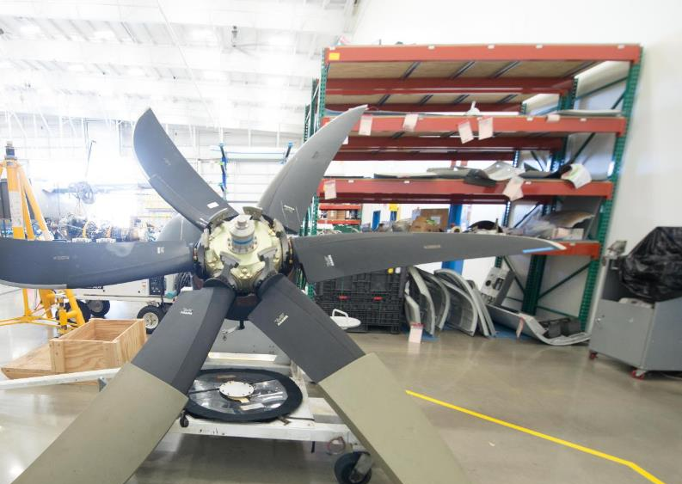
Aircraft Maintenance, Repair & Overhaul
205 companies
5,319 jobs
$61,100 average wages
North Carolina ranks 5th highest in the nation in MRO employment
Notes:
As North Carolina grows as a global aerospace hub, so does the industry that keeps aviation in the air. The state's maintenance, repair and overhaul, or MRO, sector employs more than 5,300 people at average wages of $61,100.
[MENTION ANY LOCAL MROs THAT OPERATE AT YOUR AIRPORT]

Slide 10
Military Aviation
8 military bases
156,000 employees
18,000 trained veterans exit service annually
Notes:
Synergies among North Carolina’s eight military installations, public airports and the companies that serve and supply them contribute significantly to the state’s economic growth.
Military aviators use public airports to conduct training operations, refuel and receive maintenance and repair services, which drive local business activity.
And importantly, more than 18,000 skilled civilians and veterans leave the military each year, providing experienced talent for the state’s aviation workforce.
[MENTION ANY IMPACT AT YOUR AIRPORT FROM MILITARY AVIATION]

Slide 11
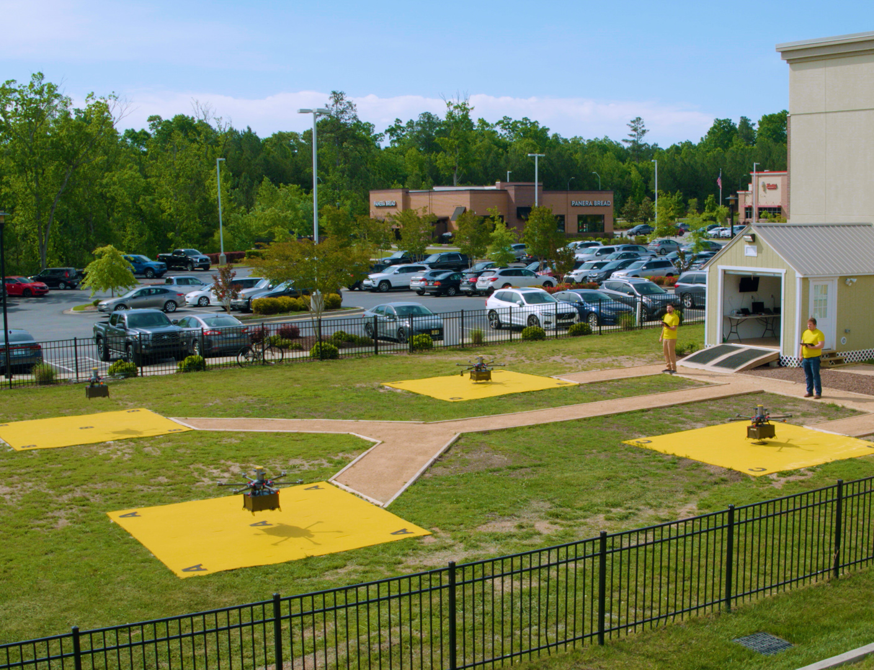
Uncrewed Aircraft Systems (UAS, or Drones)
240 UAS companies
N.C. leading the way in drone medical delivery, backyard food delivery, transportation infrastructure inspection
Notes:
Uncrewed aircraft systems, (UAS, or drones) offer the potential to transform how we live and work but require a complex system of infrastructure and regulation to do so.
North Carolina has been at the forefront of developing such a system since 2014 and continues to achieve significant advances in drone use for business and government purposes.
These successes are bringing a growing companies to North Carolina that are involved in developing or using drones to support their operations, and we expect that trend to continue.
A photo of the four launchpads at the Flytrex Holly Springs retail delivery operation, partnered with Causey Aviation Unmanned.

Slide 12
Aviation Education
31,000 STEM post-secondary graduates annually
4 universities with BS+ in aviation-related fields
7 community colleges/ 1 private college with associate degrees, diplomas, certificates
50 Flight Schools
Notes:
North Carolina’s higher education system provides strong support for aviation, with more than 28 degree programs relevant to aviation and the aerospace sector.
More than 31,000 students graduate with STEM-related degrees from North Carolina institutions each year to support the state’s aviation talent pipeline.
[MENTION HOW EDUCATIONAL INSTITUTIONS IN YOUR COMMUNITY SUPPORT AVIATION, IF THEY DO]

Slide 13
Annual Economic Impacts of [Your Airport Name]
$ XXX economic output
XXX jobs
$ XXX personal income of workers in those jobs
$XXX state and local tax revenues
[CUSTOMIZE THIS SLIDE BY FILLING IN YOUR IMPACT DATA; add a photo of your airport]

Slide 14
Supporting the Community and the Economy
[CUSTOMIZE AND ADD IMAGES IF YOU LIKE, OF THE WAYS YOUR AIRPORT SUPPORTS YOUR COMMUNITY AND ITS ECONOMY]
Aerial agricultural applications
Aerial firefighting
Aerial ambulance
Air Taxi / Passengers on-demand
Air tours
Business / corporate use
Disaster relief
Drug enforcement
Flight instructions
Overnight packages
Personal / Recreation
Power line inspections
Search and rescue
Traffic advisory
Transporting human organs
Weather observations
Wildlife management
Notes:
[Highlight the many ways your airport support the community and its economy.]

Slide 15
Airport Infrastructure Development Projects
OPTIONAL – HIGHLIGHT THE DEVELOPMENT PROJECTS UNDER WAY OR PLANNED AT YOUR AIRPORT
Notes:
[OPTIONAL: Highlight recent, current and planned airport projects that support your economic impact. The script can say something like this:]
The new _____________ moves the airport’s master plan forward and prepares us for continued growth in utilization. (Explain)
By prioritizing this/these significant project(s) now, we are positioning the airport to attract additional air service to our community in the future.
The airport will be able to attract an additional ______ tenants after this construction is complete, contributing up to $_____ more to the annual operating revenues.

Slide 16
Questions?

Slide 17
Thank you for your support of aviation in North Carolina and [Your Airport Name]!
YOUR AIRPORT LOGO
Contact:
YOUR NAME
YOUR TITLE
YOUR AIRPORT NAME
PHONE NUMBER
EMAIL
WEB ADDRESS
Notes:
We appreciate the support this community gives to the airport.
Please feel free to contact me if you have questions or connections with aviation-related businesses that can help us expand our impact even more.

